Slide 1


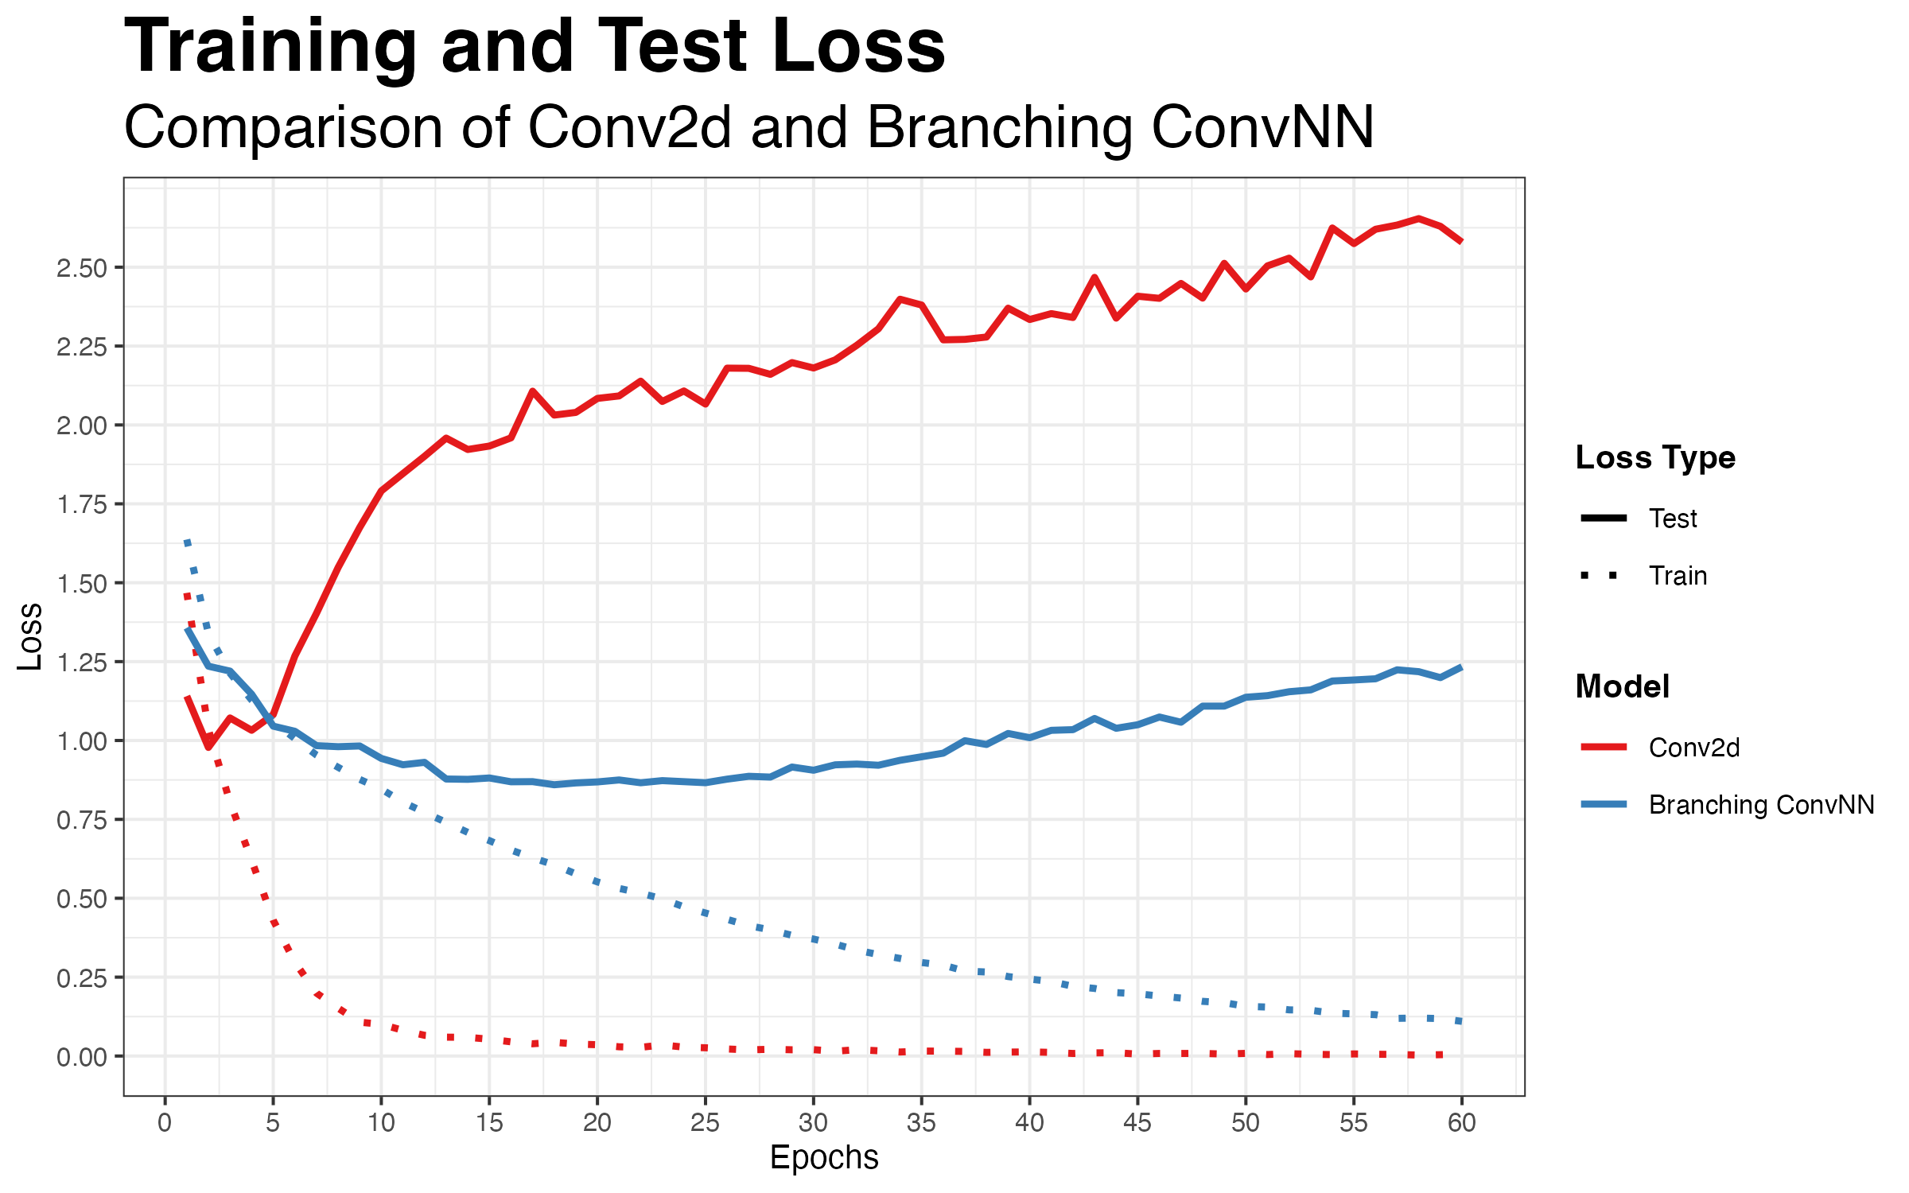
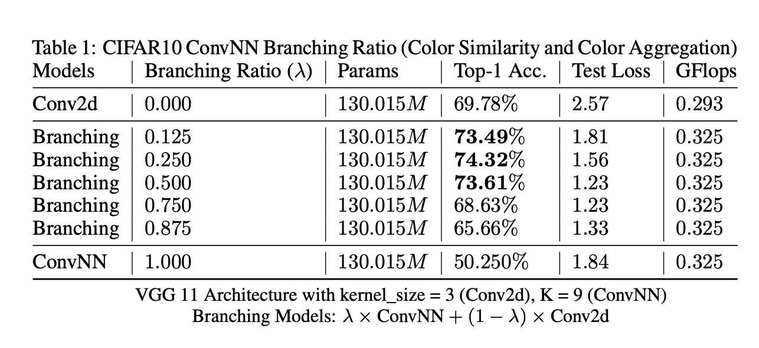
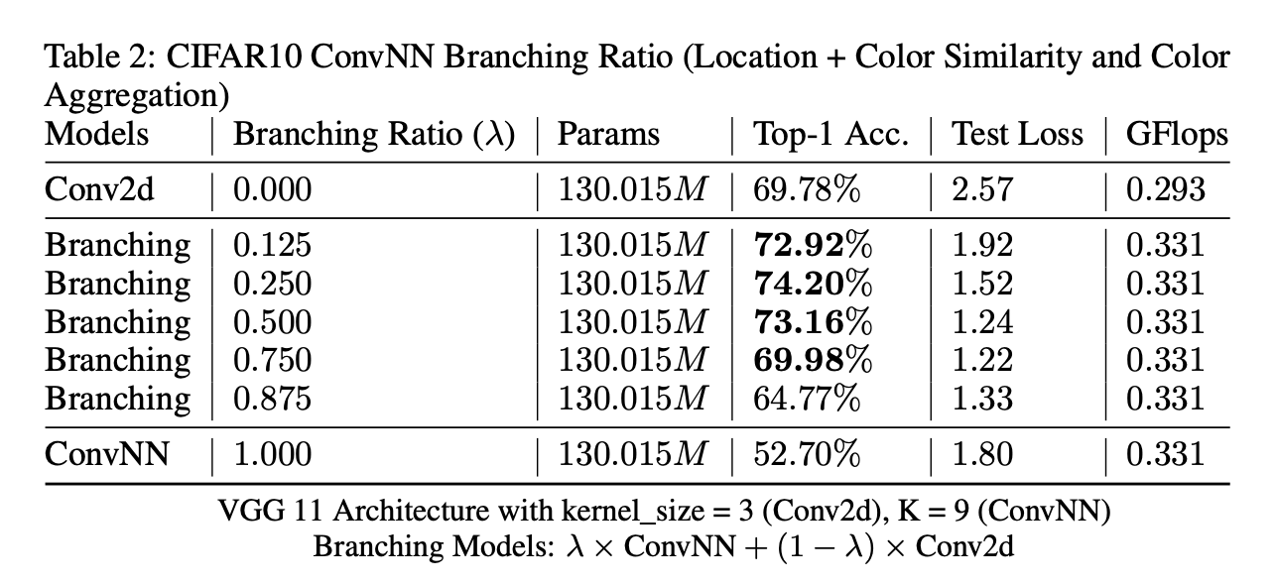
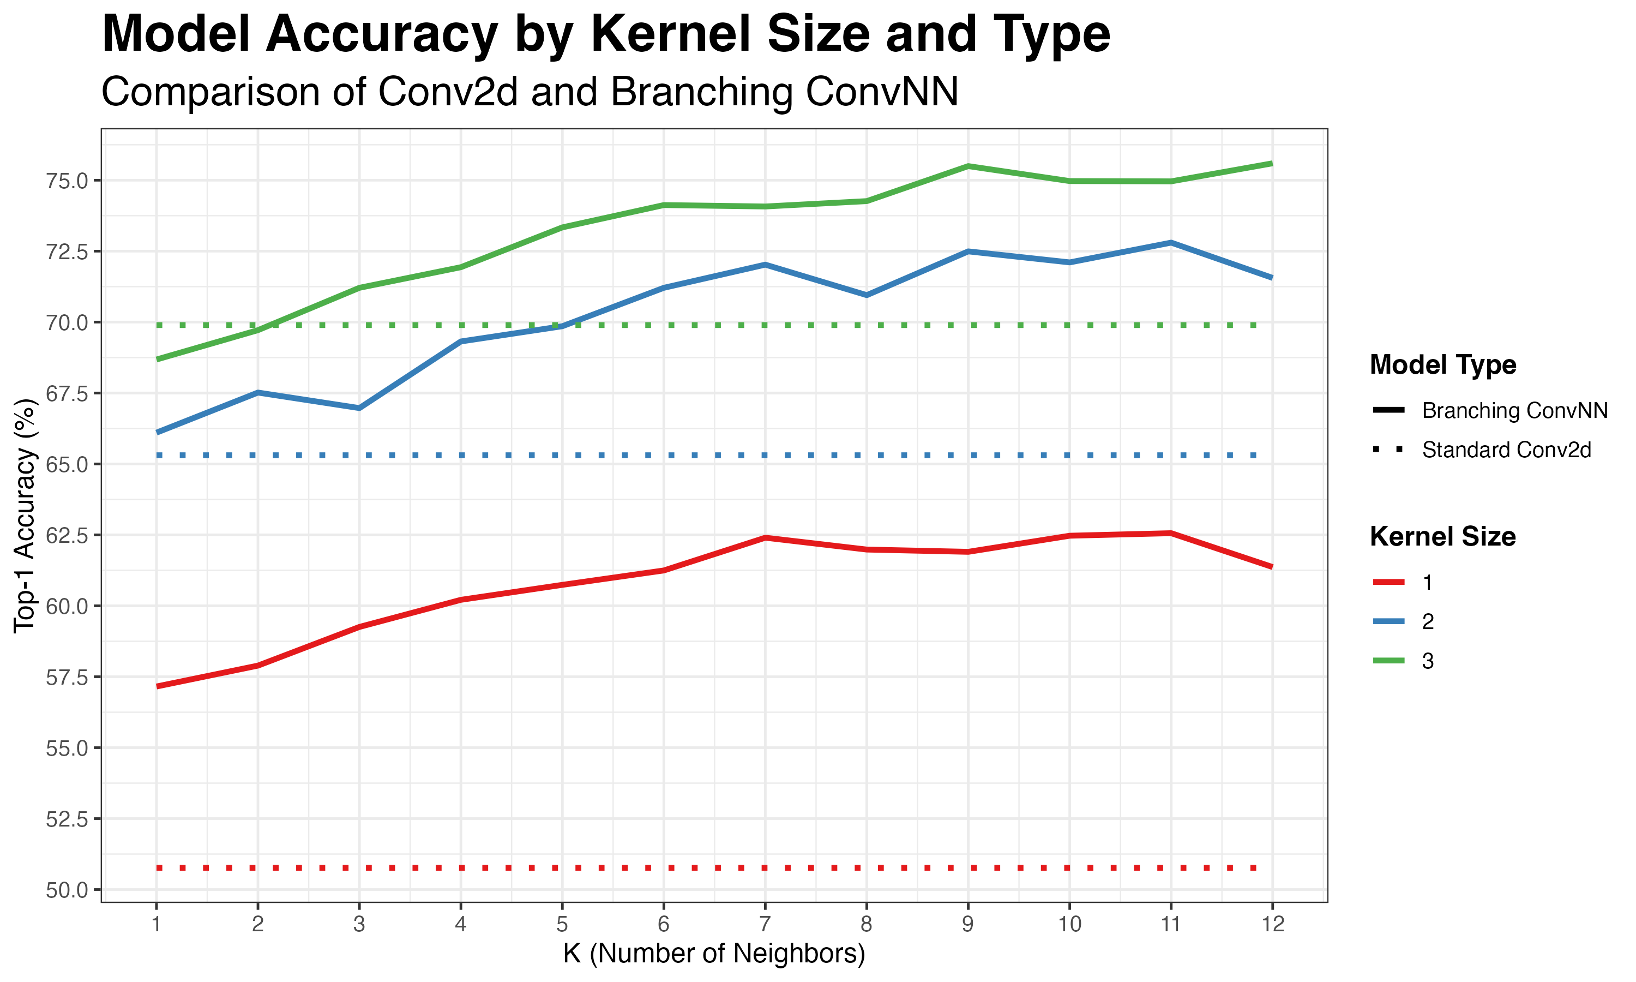
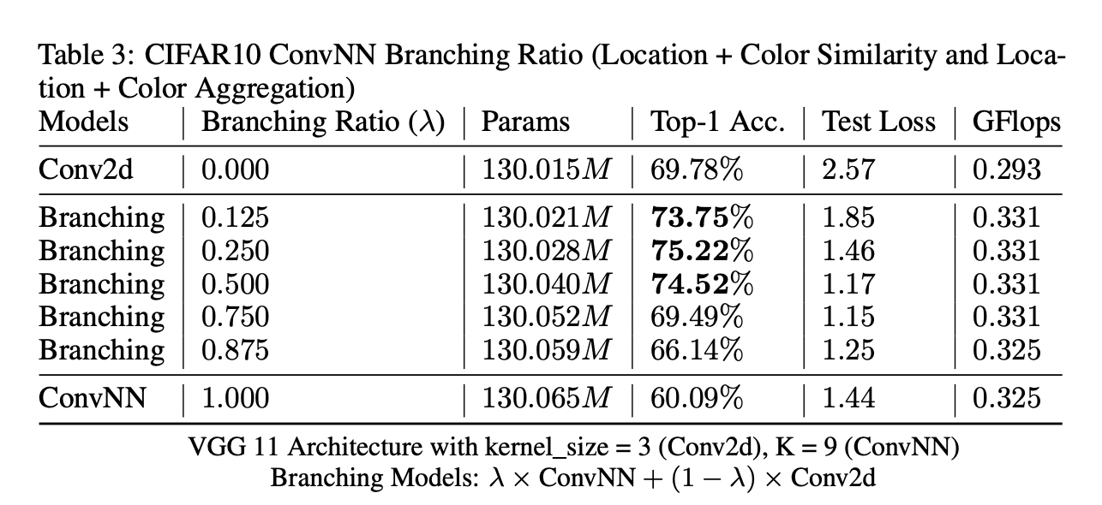
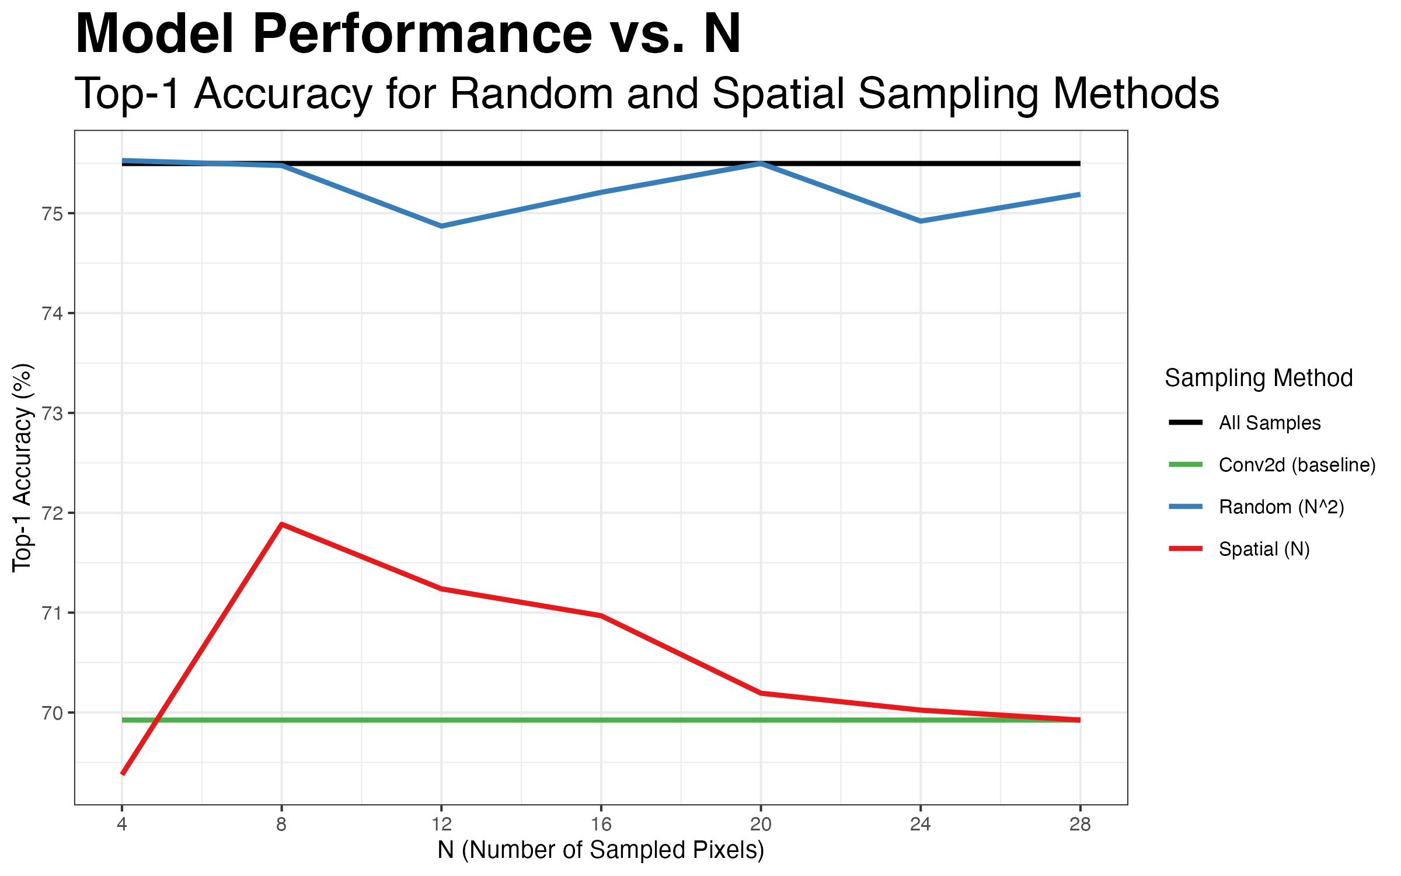
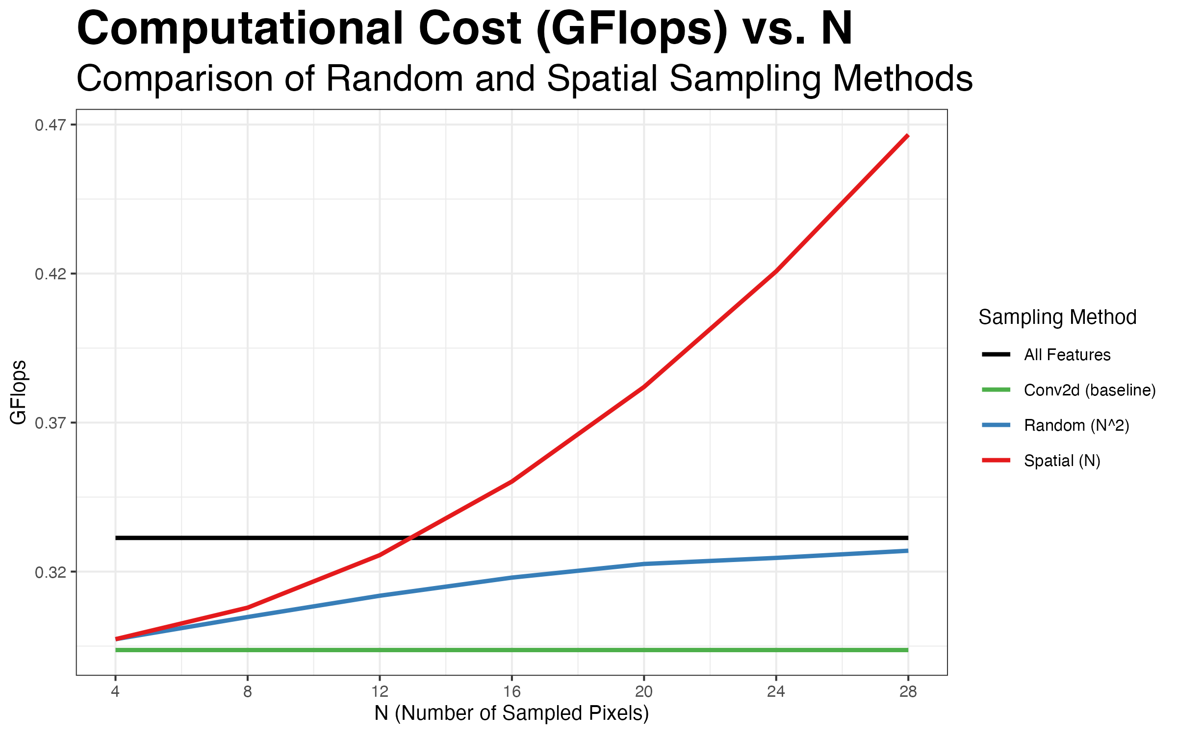
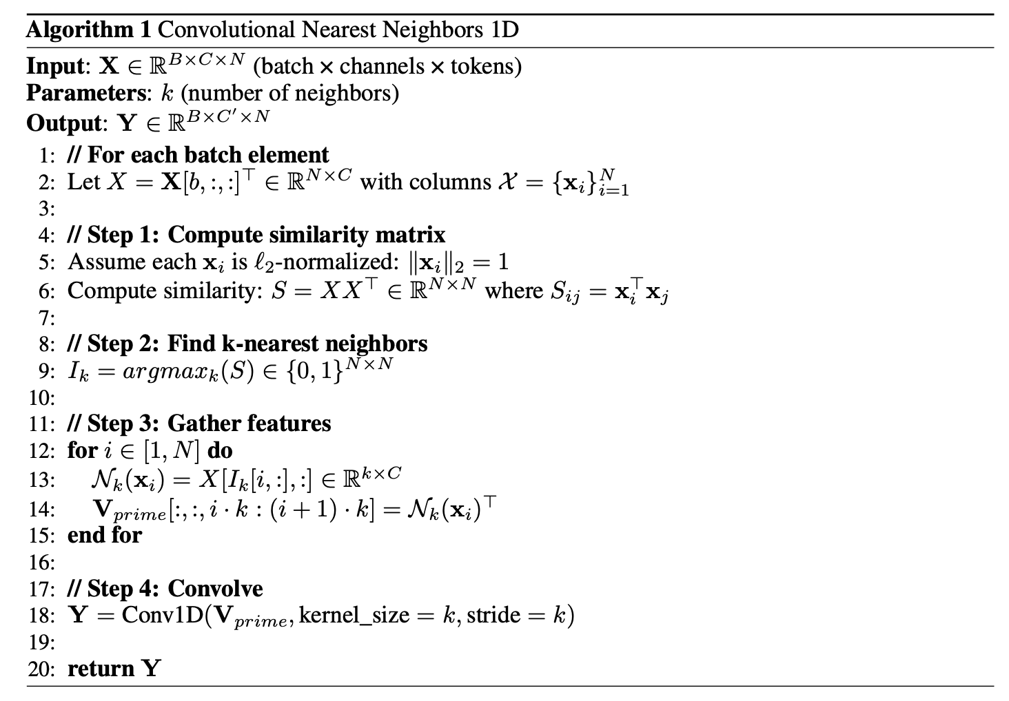
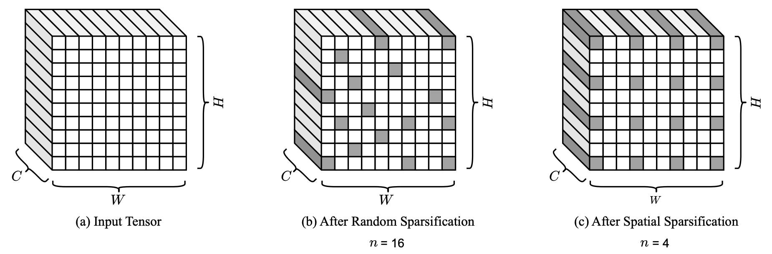
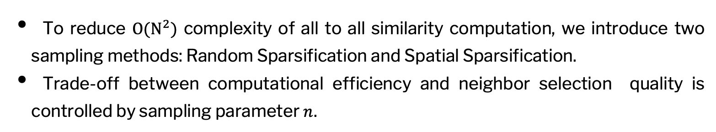

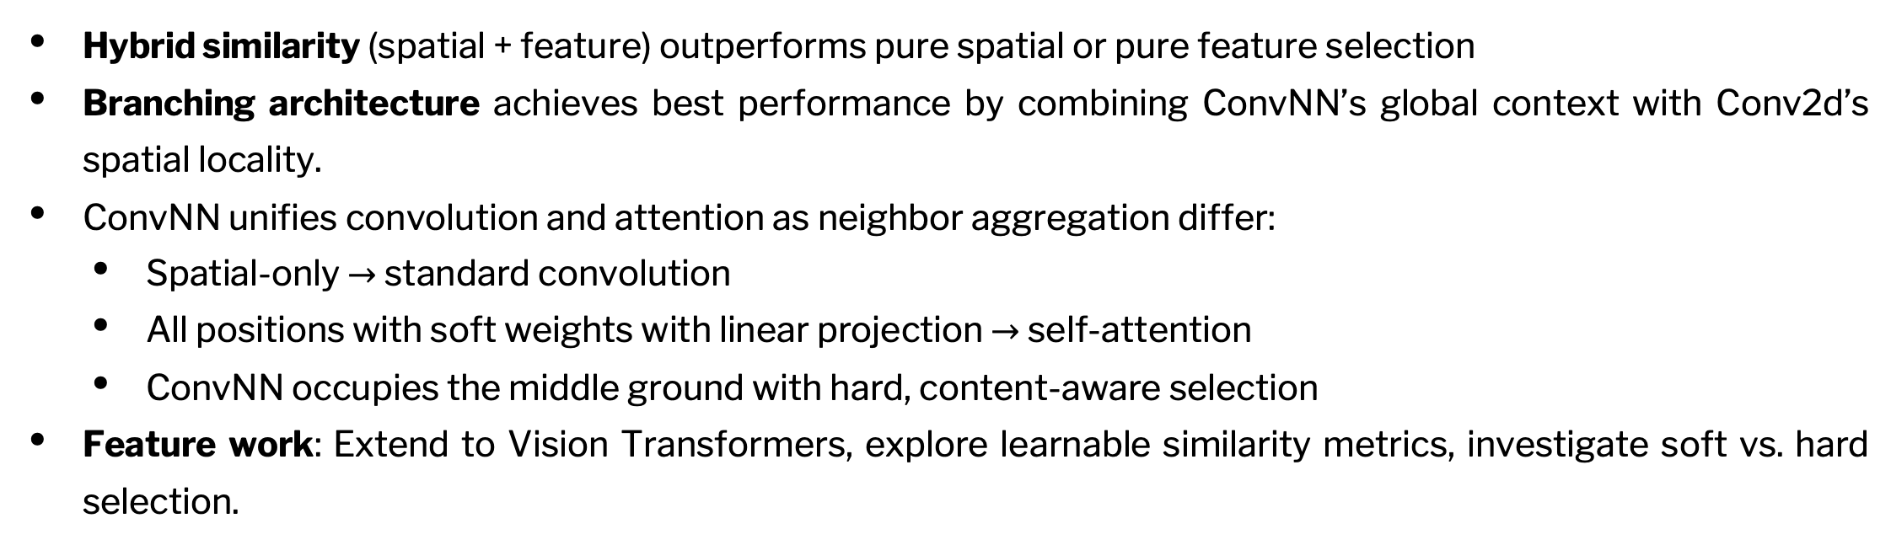
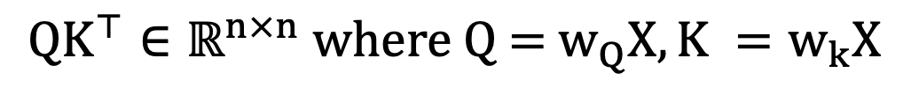
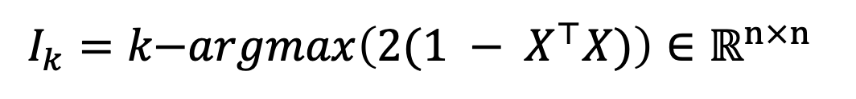
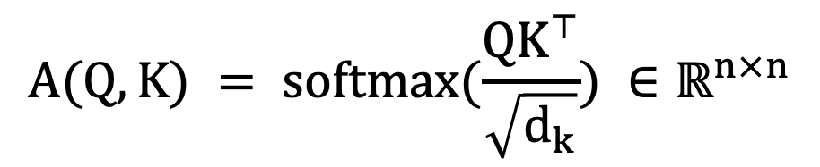
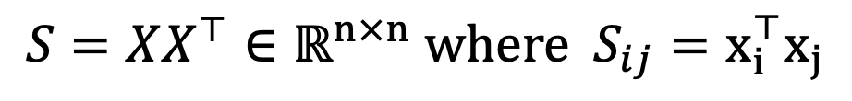
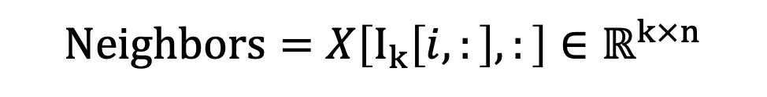
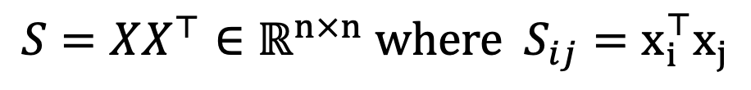
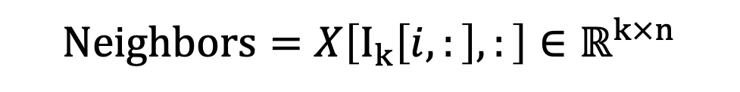
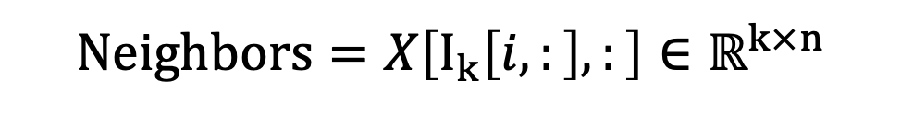
Convolutional Nearest Neighbors: Reinterpreting Convolution Through K-Nearest Neighbor Selection
Mingi Kang, Jeova Farias Sales Rocha Neto PhD.
Bowdoin College, ME
INTRODUCTION
RESULTS
Convolutional Nearest Neighbor (ConvNN) reinterprets convolution as k-nearest neighbor aggregation with flexible neighbor selection criteria.
Standard convolution implicitly performs k-NN with fixed spatial distance (e.g., 3x3 kernel = k = 9 spatially-adjacent neighbors including self).
ConvNN generalizes this by allowing neighbor selection based on:
Spatial distance (reduces to standard convolution)
Feature similarity (cosine/Euclidean)
Hybrid spatial-feature metrics
Core Algorithm of ConvNN:
1. Compute pairwise similarities between all spatial positions
2. Select k-nearest neighbors per position via hard top-k
3. Aggregate neighbors with learnable weights (1D convolution)
BASE ALGORITHM
Branching ConvNN = Branching with branching ratio 0.500, kernel_size = 3, K = 9, Feature Similarity and Aggregation.
ConvNN Visualization
1. Similarity Computation
$$S=XX^{⊤}∈ℝ^{n×n} \text{where}{ S}_{ij}=x_{i}^{⊤}x_{j}$$
2. K-Nearest Neighbor Selection
Branching ConvNN = Branching with branching ratio 0.250, Location + Feature Similarity and Aggregation.
$$I_{k}=k\text{−}argmax\left(XX^{⊤}\right)∈ℝ^{n×n}$$
$$\text{N}\text{eighbors}=X\left[I_{k}\left[i,:\right],:\right]∈ℝ^{k×n}$$
Branching ConvNN = Branching with branching ratio 0.250, Location + Feature Similarity and Aggregation. Spatial Sampling $=N=N×N \text{sub} \text{grid}\text{ 3}$, Random Sampling = $N^{2}$ pixels.
CONVOLUTION AND ATTENTION
1. Convolution
$$S=D= 2(1 − X^{⊤}X)∈ℝ^{n×n} \text{where}{ D}_{ij}= {∥x_{i} − x_{j}∥}_{2}^{2} = 2(1 − x_{i}^{⊤}x_{j})$$
$$I_{k}=k\text{−}argmax\left(2(1 − X^{⊤}X)\right)∈ℝ^{n×n}$$
SIMILARITY COMPUTATION SPEED-UPS
2. Convolutional Nearest Neighbor
$$\text{N}\text{eighbors}=X\left[I_{k}\left[i,:\right],:\right]∈ℝ^{k×n}$$
$$S=XX^{⊤}∈ℝ^{n×n} \text{where}{ S}_{ij}=x_{i}^{⊤}x_{j}$$
$$I_{k}=k\text{−}argmax\left(XX^{⊤}\right)∈ℝ^{n×n}$$
3. Attention
$$\text{N}\text{eighbors}=X\left[I_{k}\left[i,:\right],:\right]∈ℝ^{k×n}$$
$${QK}^{⊤}∈ℝ^{n×n} \text{where} \text{Q}\text{ = }w_{Q}X, K =w_{k}X$$
To reduce $O(N^{2})$ complexity of all to all similarity computation, we introduce two sampling methods: Random Sparsification and Spatial Sparsification.
Trade-off between computational efficiency and neighbor selection quality is controlled by sampling parameter $n$.
$$A(Q, K) = softmax(\frac{{QK}^{⊤}}{\sqrt{d_{k}}}) ∈ℝ^{n×n}$$
$$Attention(Q, K, V) =A(Q, K)V where V =w_{v}X$$
ARCHITECTURE AND TRAINING
DISCUSSION
Architecture: VGG-11 with Conv2d layers replaced by ConvNN and branching layers
Dataset: CIFAR-10 image classification
Training: 60 epochs with AdamW (lr=1e-5, wd=1e-6), StepLR scheduler (gamma=0.95, step=2)
Variants tested:
Location-only (spatial distance)
Feature-only (cosine similarity)
Hybrid (weighted combination)
Branching with ratio (e.g., 50% Conv2d + 50% ConvNN)
Hybrid similarity (spatial + feature) outperforms pure spatial or pure feature selection
Branching architecture achieves best performance by combining ConvNN’s global context with Conv2d’s spatial locality.
ConvNN unifies convolution and attention as neighbor aggregation differ:
Spatial-only $→$ standard convolution
All positions with soft weights with linear projection $→$ self-attention
ConvNN occupies the middle ground with hard, content-aware selection
Feature work: Extend to Vision Transformers, explore learnable similarity metrics, investigate soft vs. hard selection.
REFERENCES
A. Buades, B. Coll and J. . -M. Morel, "A non-local algorithm for image denoising," 2005 IEEE Computer Society Conference on Computer Vision and Pattern Recognition (CVPR'05), San Diego, CA, USA, 2005, pp. 60-65 vol. 2, doi: 10.1109/CVPR.2005.38.
Singh, Sidak Pal, and Martin Jaggi. "Model fusion via optimal transport." Advances in Neural Information Processing Systems 33 (2020): 22045-22055.
Plötz, Tobias, and Stefan Roth. "Neural nearest neighbors networks." Advances in Neural information processing systems 31 (2018).
Wang, Xiaolong, et al. "Non-local neural networks." Proceedings of the IEEE conference on computer vision and pattern recognition. 2018.
Vaswani, Ashish, et al. "Attention is all you need." Advances in neural information processing systems 30 (2017).

